Slide 1
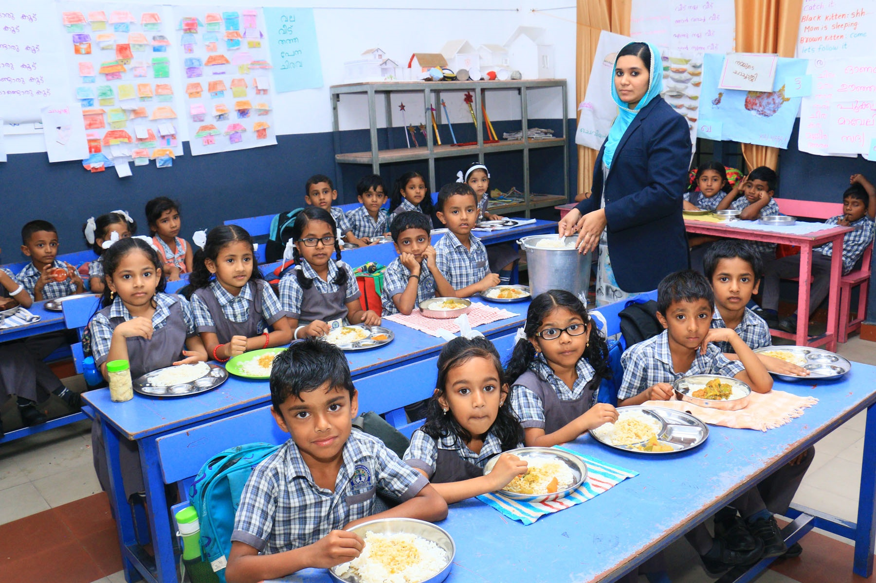
National Programme of Mid Day Meal
GENERAL EDUCATION DEPARTMENT GOVERNMENT OF KERALA
A KERALA PERSPECTIVE

Slide 2
ATR ON THE MINUTES OF MDM-PAB MEETING HELD ON 10.05.2018
State could not achieve 220 working days in upper primary during the year 2018-19 because of the devastating floods that ravaged the State during the months of August & September
In the aftermath of the floods, District Collectors were so preoccupied with rehabilitation and relief operations, DLSMCs could not be convened regularly. However a total of 29 meetings were held during the year 2018-19
All schools have provisions to provide safe drinking water to
children.
State will explore the possibility of providing millets to children at least once in every week.

Slide 3
ATR ON THE MINUTES OF MDM-PAB MEETING HELD ON 10.05.2018
Steps have been taken to ensure the hygiene and nutritional value of meal given to children. 7977 food samples that got tested in 2018-19,only five samples did not meet the norms.
Nutrition gardens have been set up in 7325 schools which need to be further developed. Efforts are on to develop the existing ones and to set up gardens in the remaining 5016 schools using FLEXI Funds
Percentage of daily data reporting under AMS has been
enhanced to 87 %

Slide 4
Innovative Practices/Salient Features
High student coverage (97% in Primary & 91% in Upper Primary) against Enrolment
Wider community participation at school level
Enhanced State share towards Cooking Cost. State puts Rs. 3.65/- and Rs. 1.49/- over and above its mandatory share in primary & upper primary repectively.
CCH are provided with a minimum honorarium of Rs 400/- per
day to a maximum of Rs.475/- per day.
Funds for meeting cooking cost and CCH honorarium are released in advance. All transactions are effected through e-transfer mode.

Slide 5
Innovative Practices/Salient Features
State budgetary provision (during February every year) includes central assistance as well as state share. When centre releases its share, the budgetary provision is recouped.
Kitchen Gardens have been set up in 7325 schools in convergence with State Agriculture Department & other agencies such as Mathrubhumi SEED
2927 schools (30%) have ongoing scheme for breakfast (with the financial assistance of LSG institutions, School PTAs, Charitable Institutions, etc.)
Egg/Banana are provided to children once in every week
Milk @ 150 ml per day is provided twice a week

Slide 6
Innovative Practices/Salient Features
All schools have safe drinking water facilities
Multi water tap facility is available in all schools
All schools are using LPG as fuel for cooking the meal
Every children is provided with 5 kg raw food grains free of
cost during Onam Festival occasion ( State intervention)
SMC/MPTA members and teachers taste the meal before it is served.

Slide 7
Innovative Practices/Salient Features
Food and water samples are regularly tested for microbiological & chemical parameters in NABL accredited laboratories
State provides assistance @ Rs.1400/- per MT to meet transportation charges over and above the central assistance of Rs.750/-
Schools receive contributions from local community members, commercial establishments in the form of water purifiers, kitchen utensils, vegetable cutting boards and aprons/headgears/gloves(for cook cum helpers)
Special dishes are served to children during festive occasions such as Onam, Christmas, Bakrid, etc

Slide 8
Innovative Practices/Salient Features
Cook-cum-helpers are given a financial assistance of Rs. 4000/- each during summer vacations
Percentage of reporting under AMS is 87%. The data is used for the proper monitoring of the Scheme.

Slide 9
ISSUES
Widespread complaints regarding the quality of food grains received from FCI.
Construction of 3031 kitchen-cum-store units could not be started during 2018-19 due to the flood situation and other issues. Construction will be taken up & completed this year.
Coverage against enrolment is lower (91 %) in upper primary as compared to that in primary (97%)

Slide 10
FLOW of FUNDS
Budgetary Provision
(GOI Share + State Share)
Director of Public Instruction (Director, MDM)
Headmasters
Districts
State Civil Supplies Corporation
Blocks (AEOs)
(Transportation Charges)
(Cooking Cost)
FCI
CCH
(Honorarium)
(Cost of Food grains)

Slide 11
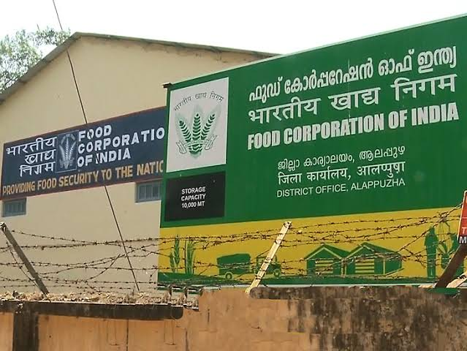
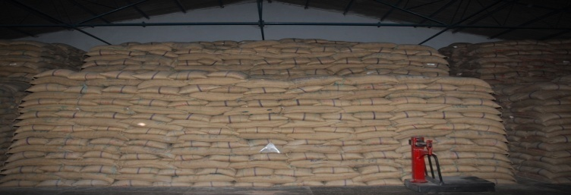
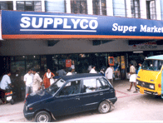
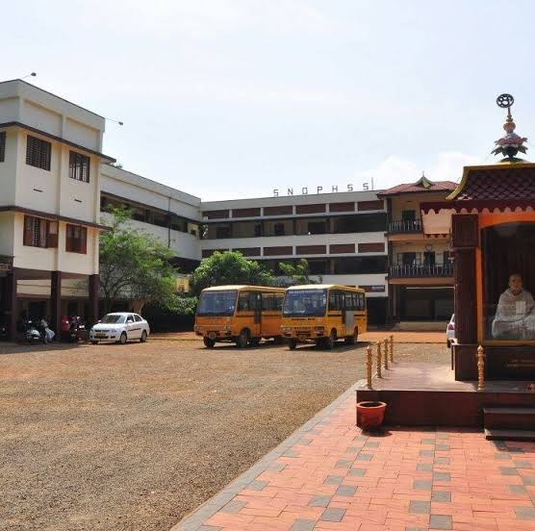
Food Grain Flow Chart
FCI
SUPPLYCO GODOWNS
SUPPLYCO OUTLETS
SCHOOLS

Slide 12
PERFORMANCE 2018-19

Slide 13
Budget for the year 2018-19
(as approved by Department of SE&L, MHRD)
The MDM-PAB Meeting that discussed the AWP&B submitted by the State Government approved a total plan outlay of 31977.22 lakh rupees for the year 2018-19. However due to revision in cooking cost w.e.f 01.4.2018 announced later, the plan outlay was enhanced to 33568.32 lakh rupees
Item/Component | Centre share (in lakhs) | State mandatory share (in lakhs) | Total Plan Outlay ( in lakhs)
Recurring | 21224.59 | 12343.73 | 33568.32
Non-recurring | Nil | Nil | Nil

Slide 14
STATE BUDGETARY ALLOCATION-2018-19
The allocation under plan heads is inclusive of the central assistance. Anticipating the central assistance, State Government makes advance provision for Centre share in its budget much before the funds are sanctioned/released by MHRD.
State Budget was passed in February 2018 and administrative sanction for the utilization of the entire amount allocated for MDMS was given to Nodal Department on 2nd June 2019.
Item/Component | Allocation under Plan Heads ( in lakhs) | Allocation under Non Plan (in lakhs)
Recurring | 60512 | 3100
Non Recurring | 21097.09 | Nil

Slide 15
INSTITUTIONS COVERED
Total Schools:-12341

Slide 16
INSTITUTIONS - CATEGORY WISE
Primary : 6804
Primary with Upper Primary : 4932
Upper Primary : 605
Total :12341

Slide 17
Coverage VS Enrolment 2019-20 PRIMARY UPPER PRIMARY
TOTAL
Enrolment: 1662998
Coverage : 1606107 97%
TOTAL
ENROLMENT: 1065753
COVERAGE : 972619 91%

Slide 18
FOOD GRAIN UTILIZATION (MTs)

Slide 19
COST OF FOOD GRAINS ( in lakhs)
Bill raised by FCI - 1997.73 lakhs
Amount paid to FCI - 1997.73 lakhs

Slide 20
Utilization of Cooking Cost –Primary
(in lakhs)

Slide 21
Utilization of Cooking Cost- Upper Primary
(in lakhs)

Slide 22
Utilization of Fund towards CCH Honorarium Primary
(in lakhs)

Slide 23
Utilization of Funds towards CCH Honorarium Upper Primary
(in lakhs)

Slide 24
Utilization of Central Assistance towards Transportation Assistance
(in lakhs)

Slide 25
Utilization of Central Assistance towards MME (in lakhs)

Slide 26
Utilization of Assistance towards construction of Kitchen-cum-Store Units

Slide 27
SCHOOL HEALTH PROGRAMME-2019-20
CATEGORY | SCHOOLS COVERED | CHILDREN COVERED | Percentage against Enrol
Health Check up | 12341 | 2673996 | 98
IFA tablets | 5537 | 756685 | 71
Deworming tablets | 12341 | 2243495 | 82

Slide 28
Receipt & Utilization of Centre Share-2018-19-Abstract
(Rs in Lakhs)
Particulars |  | Received (in lakhs) | Utilized (in lakhs) | Balance (in lakhs)
Recurring
Cost of Food grains |  | 1848.12 | 1848.10 | 0.02
Cooking Cost |  | 17478.77 | 15947.84 | 1530.93
Transportation charges |  | 462.04 | 462.04 | 0.00
Cook-cum-Helpers |  | 1060.38 | 863.34 | 197.04
MME |  | 375.29 | 356.23 | 19.06
 |  | 21224.59 | 19477.55 | 1747.04
Non-recurring |  | Nil | Nil | Nil
GRAND TOTAL | 21224.59 |  | 19477.55 | 1747.04

Slide 29
PROPOSAL FOR 2019-20

Slide 30
PROPOSED COVERAGE OF CHILDREN FOR 2019-20

Slide 31
INSTITUTIONS – PROPOSED FOR 2019-20
Primary : 6804
Primary with Upper Primary : 4932
Upper Primary : 605
Total :12341

Slide 32
WORKING DAYS, FOODGRAINS & CCH PROPOSAL F0R 2019-20
DIVISION | WORKING DAYS | FOODGRAINS (in MT) | CCH | REMARKS
PRIMARY | 200 | 32223.48 | 9217 | No change in the number of CCH
UPPER PRIMARY | 220 | 32636.34 | 8456 | No change in the number of CCH
TOTAL |  | 64859.82 | 17673

Slide 33
REPAIRS FOR KITCHEN-CUM-STORE UNITS PROPOSAL F0R 2019-20
Kitchen units constructed prior to 2008-09 | Kitchen units that require repairs | Funds required (centre share) in lakhs | Funds required (state share) in lakhs | Total Funds required (in lakhs)
1285 | 1285 | 77.1 | 51.4 | 128.5
TOTAL | 1285 | 77.1 | 51.4 | 128.5
Proposal is submitted as per the revision in guidelines and as per the rate of Rs.10,000/- per unit

Slide 34
Plan Proposal -2019-20
(Rs in Lakhs)
Particulars | Physical | Centre share |  | State share
Recurring
Cost of Food grains | 64859.82 MT |  | 1945.79 | 0.00
Cooking Cost | 2600154 |  | 16917.54 | 26267.30
Transportation charges | @1500/ per MT |  | 972.90 | 421.59
Cook-cum-Helpers | 17673 |  | 1060.38 | 14138.40
MME |  |  | 564.21 | 0.00
Sub Total |  |  | 21460.82 | 40827.29
Non-recurring ( repair of kitchens) | 1285 |  | 77.1 | 51.4
FLEXI Funds (kitchen garden & provision of seasonal fruit ) | 12341 |  | 1006.80 | 671.20
Grand Total |  |  | 22544.72 | 41549.89

Slide 35
FOCUS FOR 2019-20
Constructing Multi Purpose Dining Halls in schools in convergence with Local Self Government Institutions and with the help of MPLAD/MLALAD Funds and CSR Funds
Improving the quality and nutritive value of food
Conducting Social Audit in two districts, viz Alappuzha and Wayanad
Launching awareness programmes – organizing Cultural & Art Festivals, releasing promotional videos/films on MDMS, etc.
Setting up of Kitchen Gardens in all schools
Constructing 3031 kitchen-cum-store units and undertaking the repair of 1285 units
Procuring water purifiers with the help of CSR funds.

Slide 36
SCHOOL NUTRITION GARDENS

Slide 37
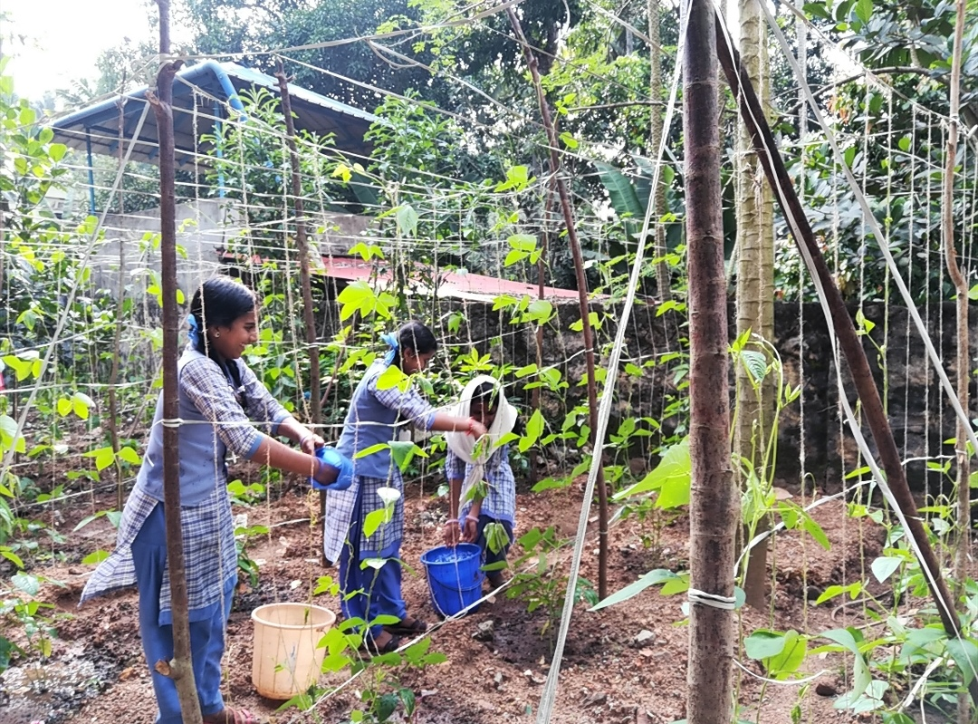

Slide 38
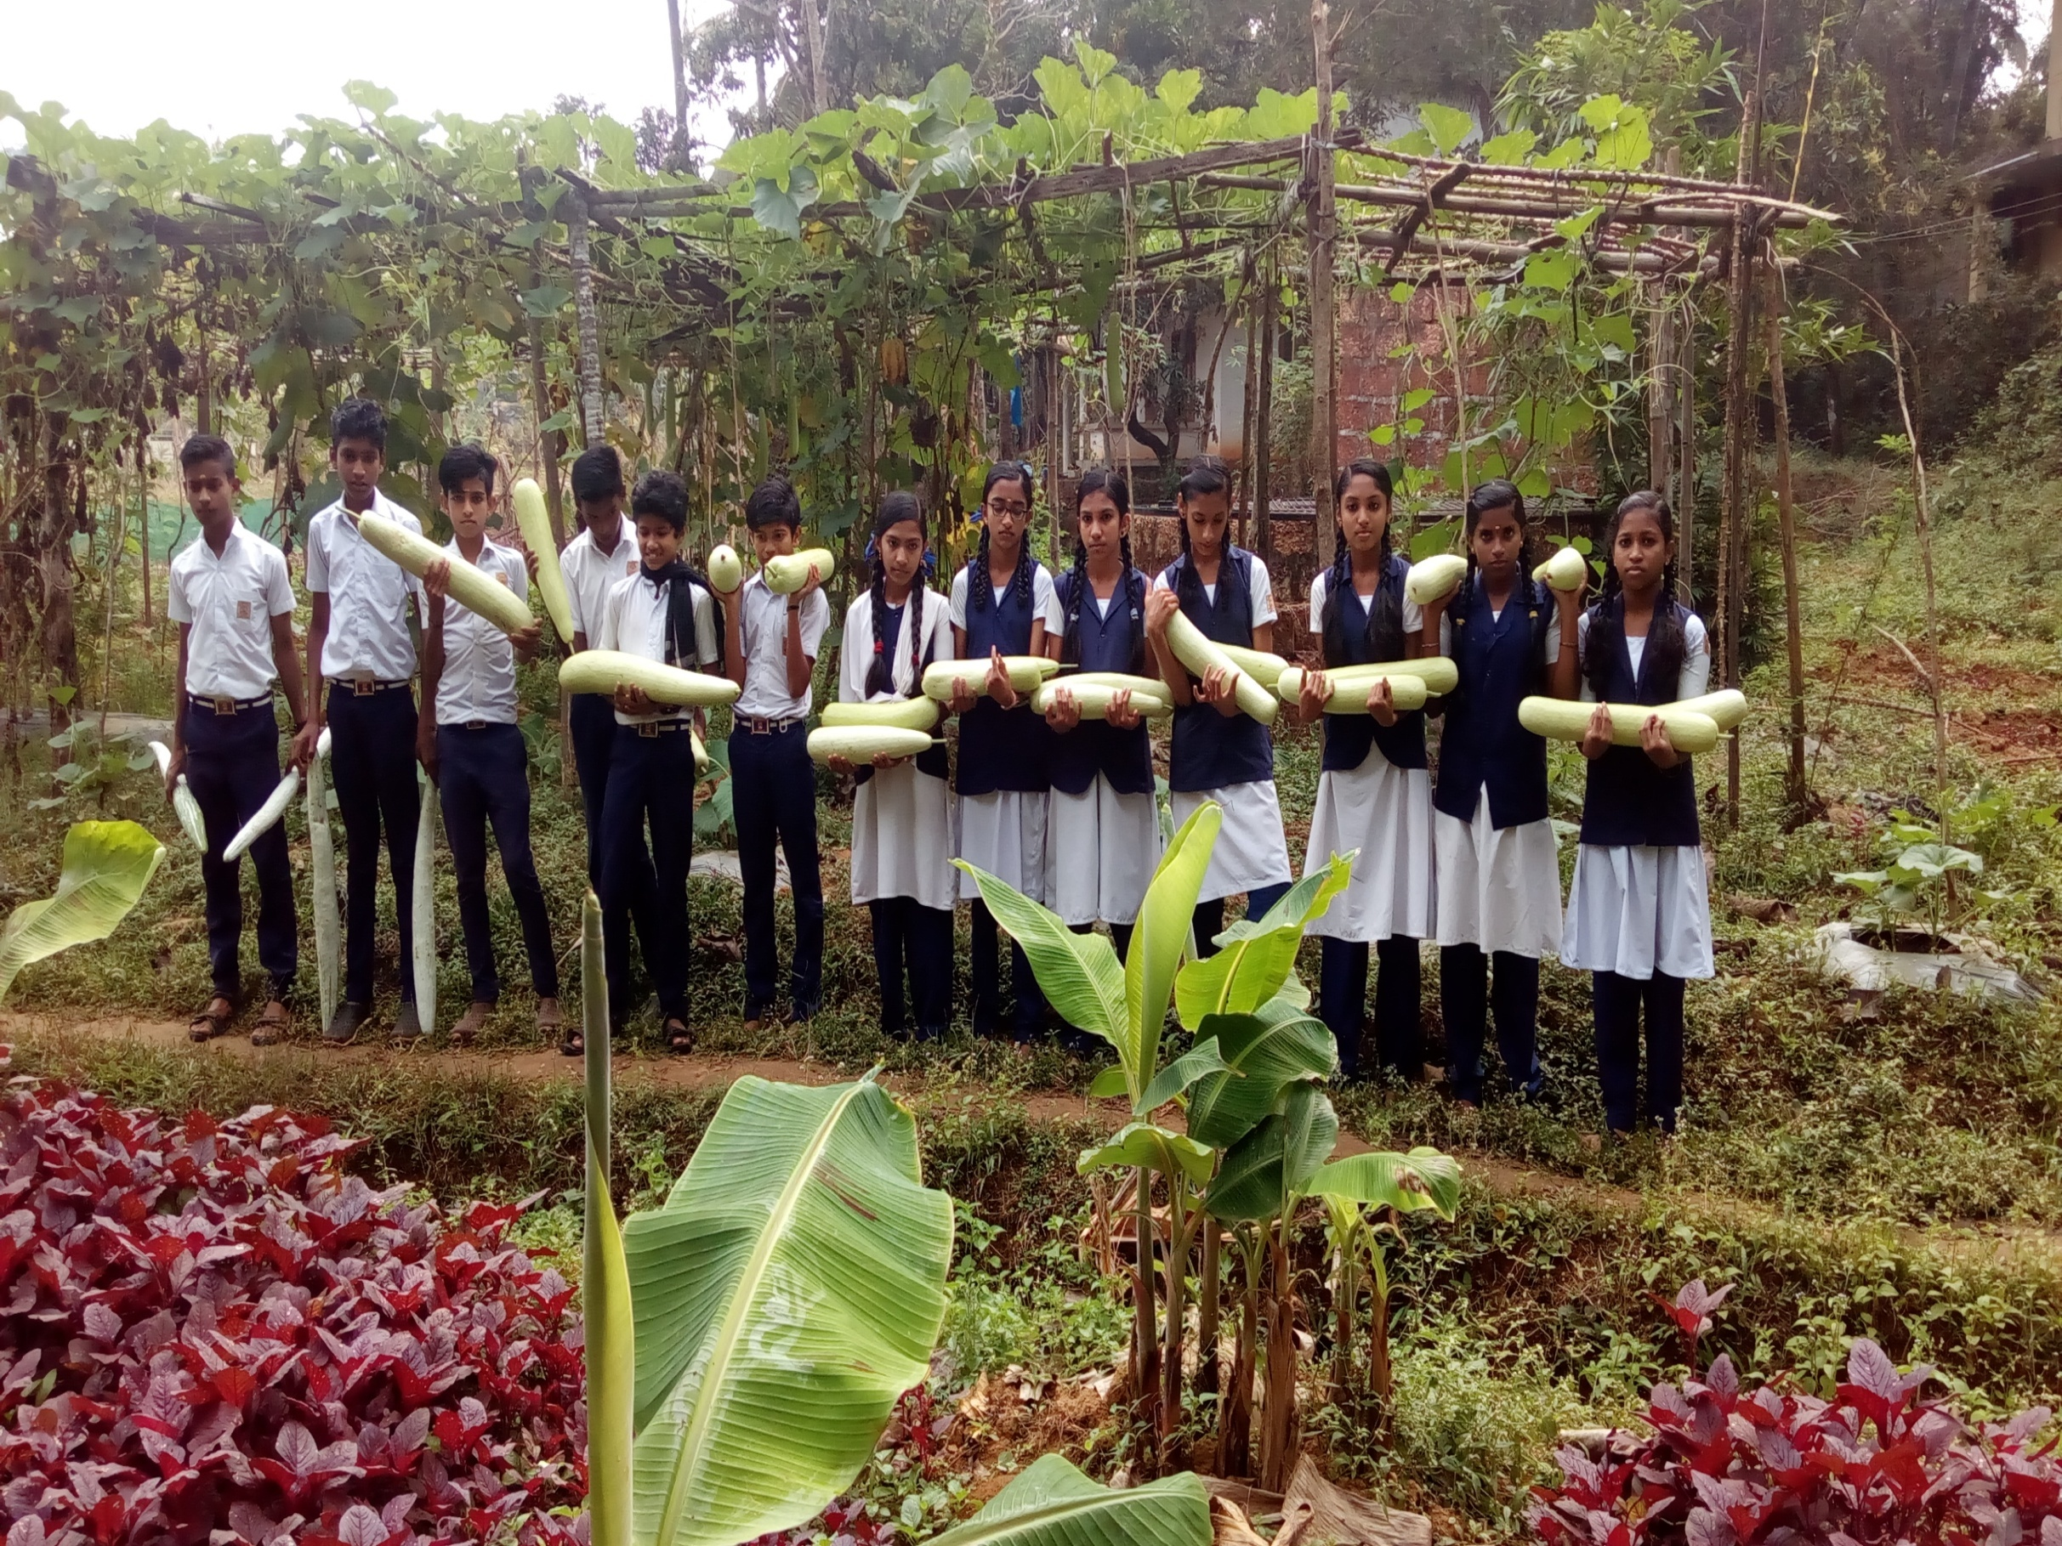

Slide 39
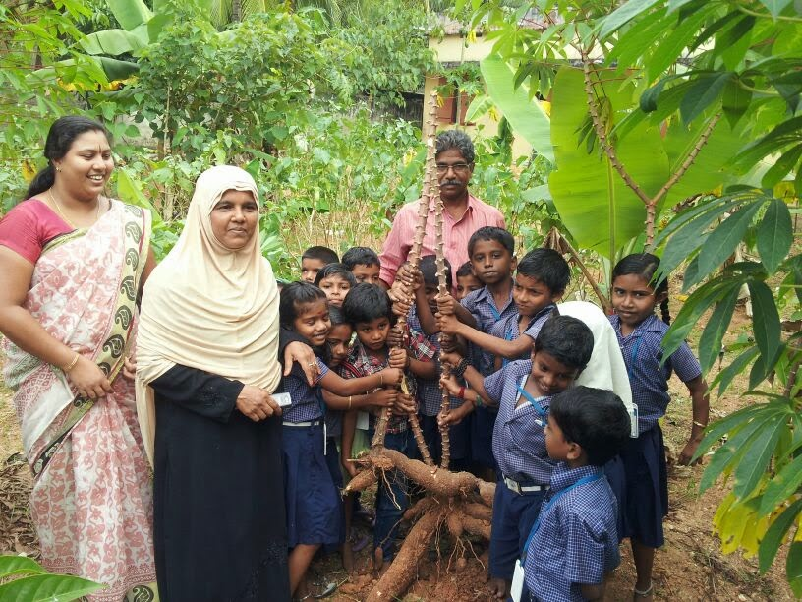

Slide 40
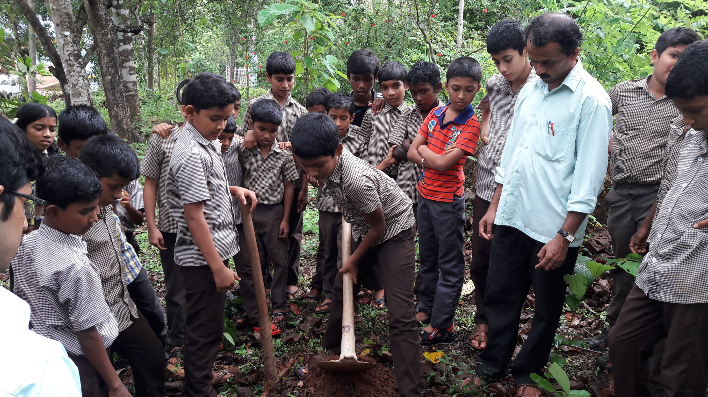

Slide 41
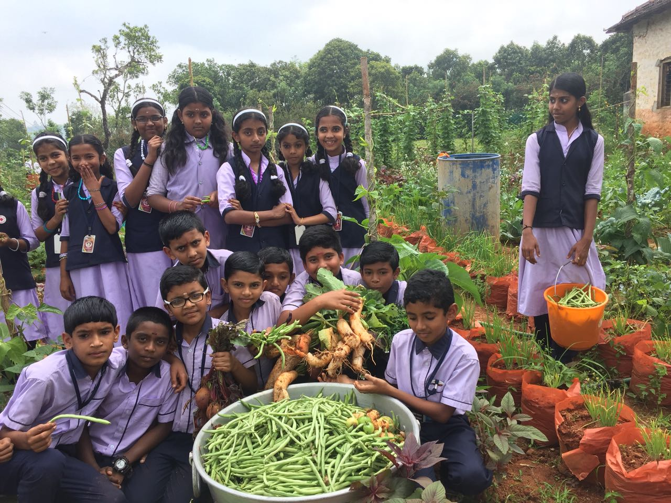

Slide 42
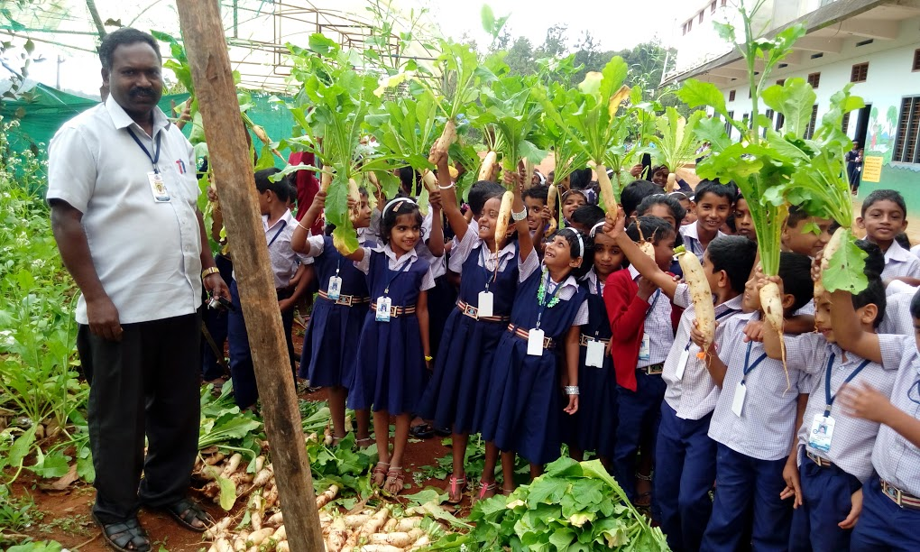

Slide 43
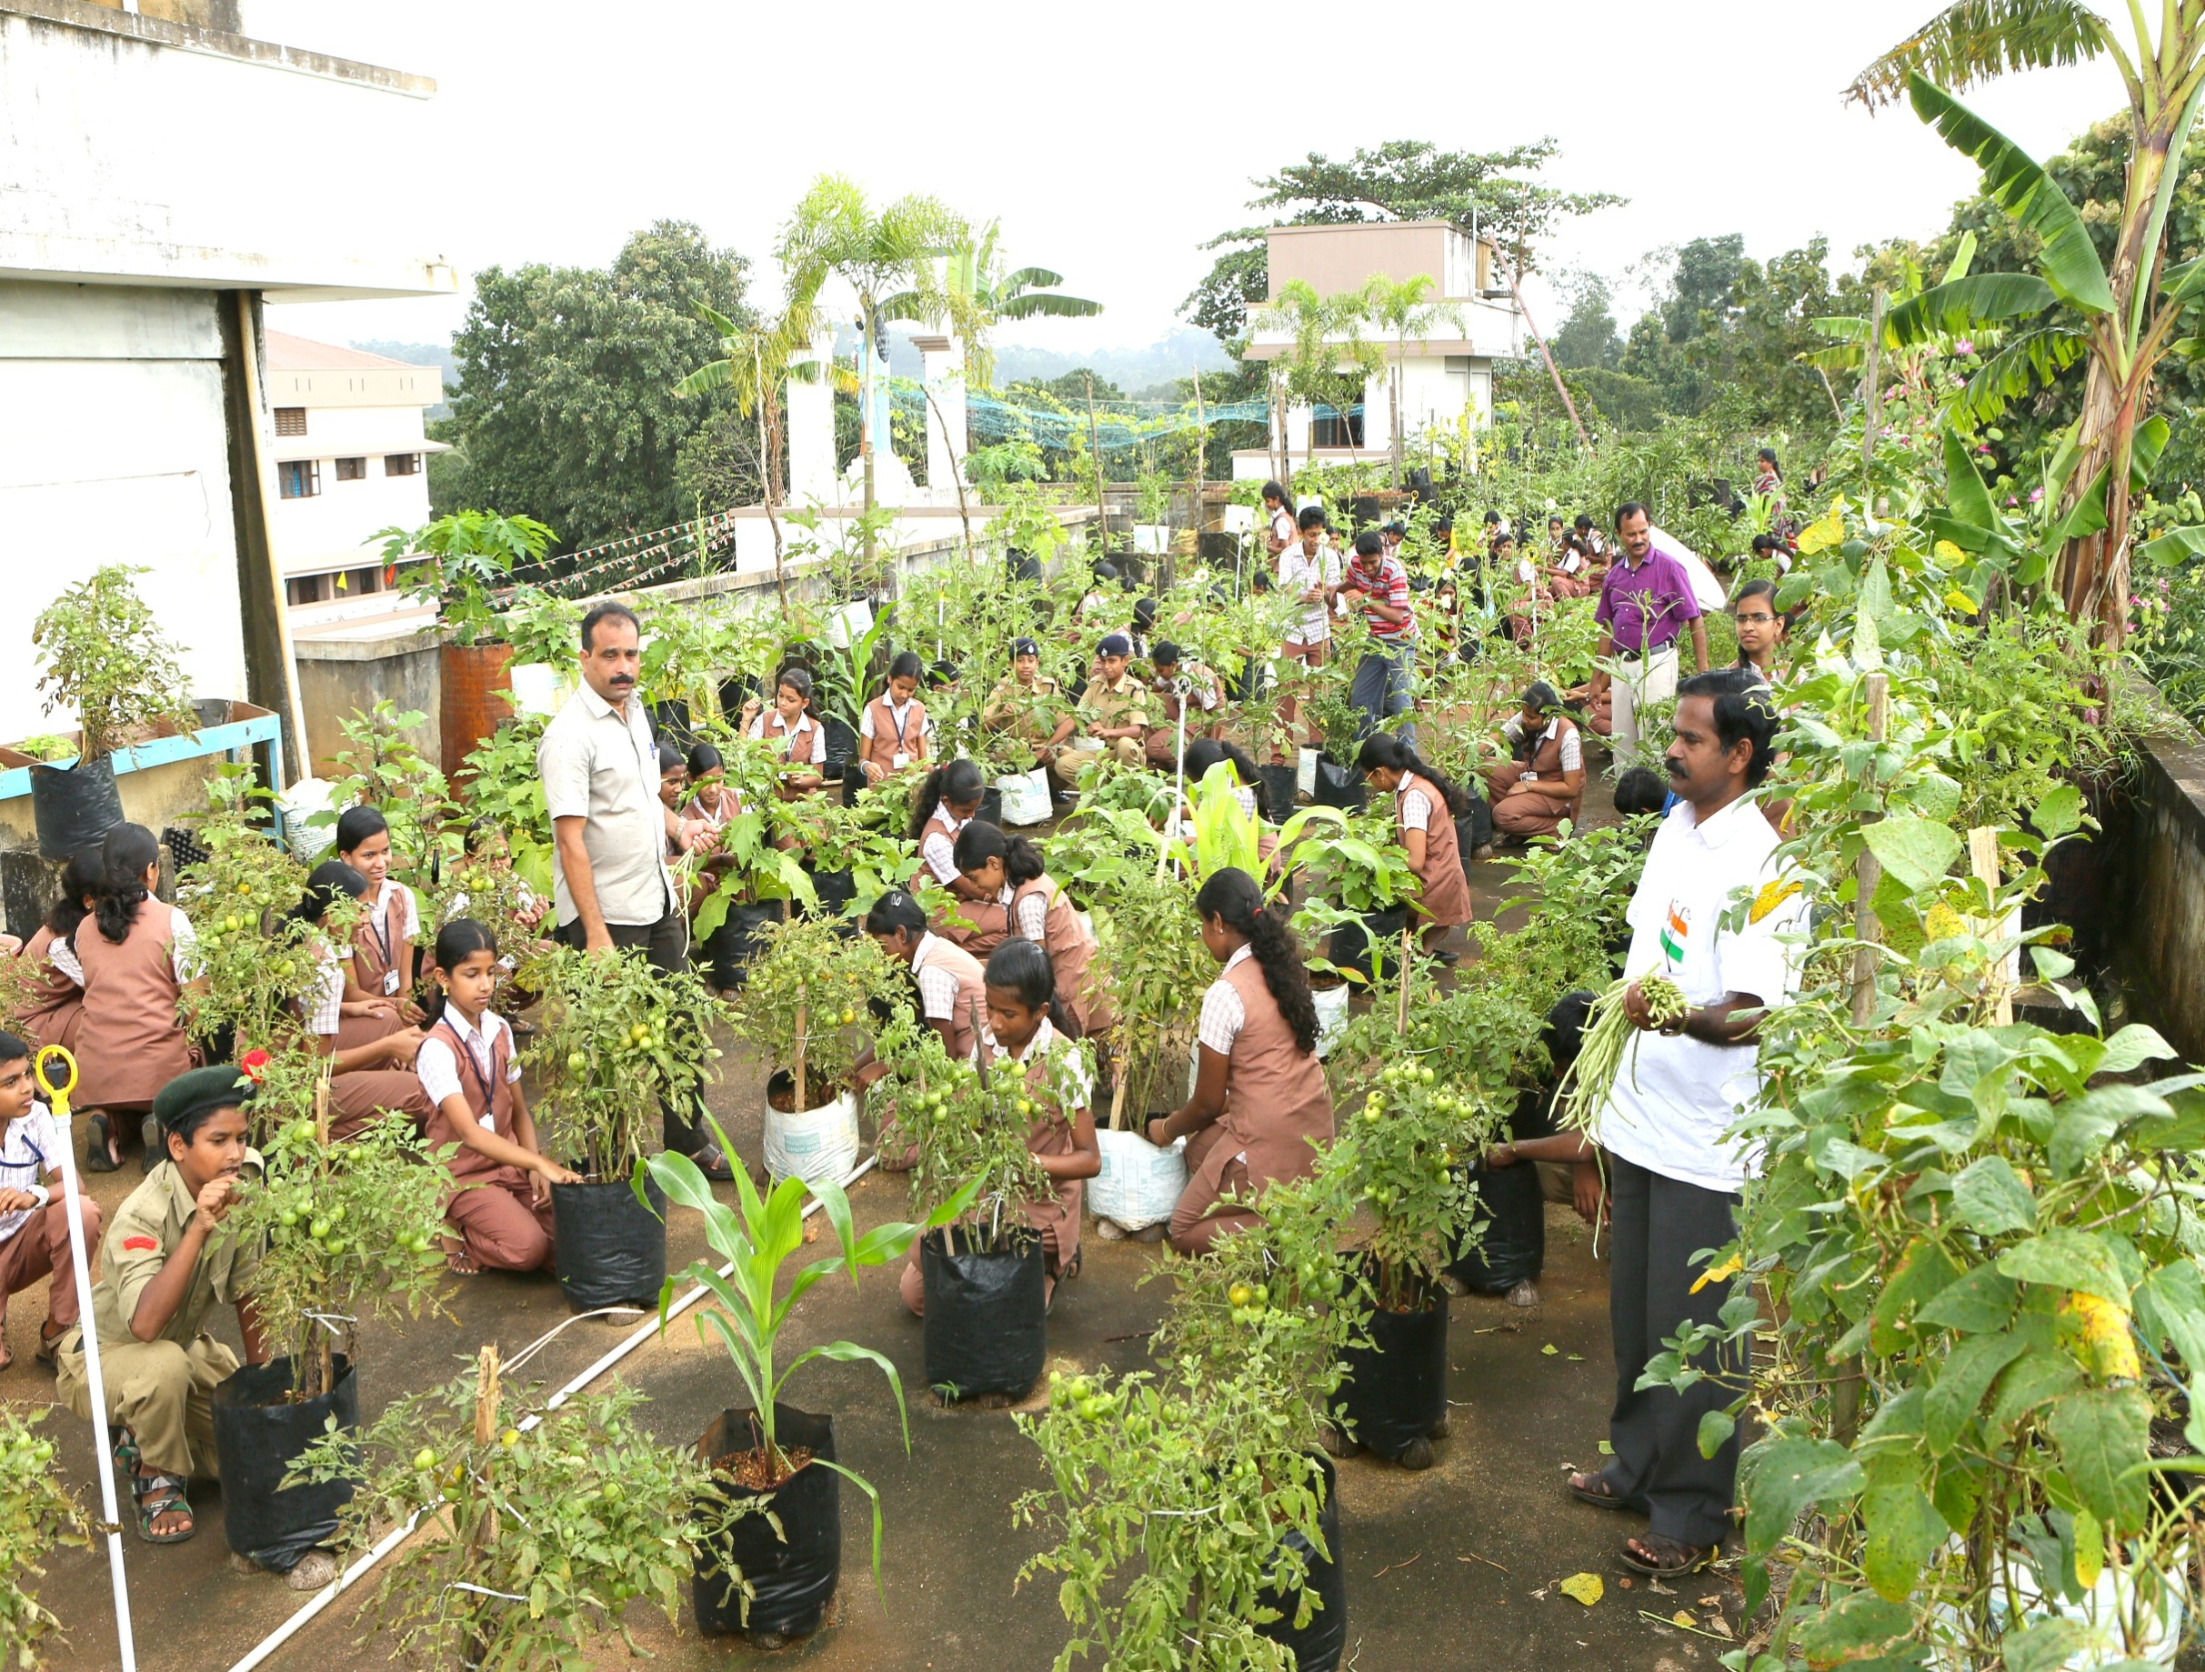
Terrace Farming

Slide 44
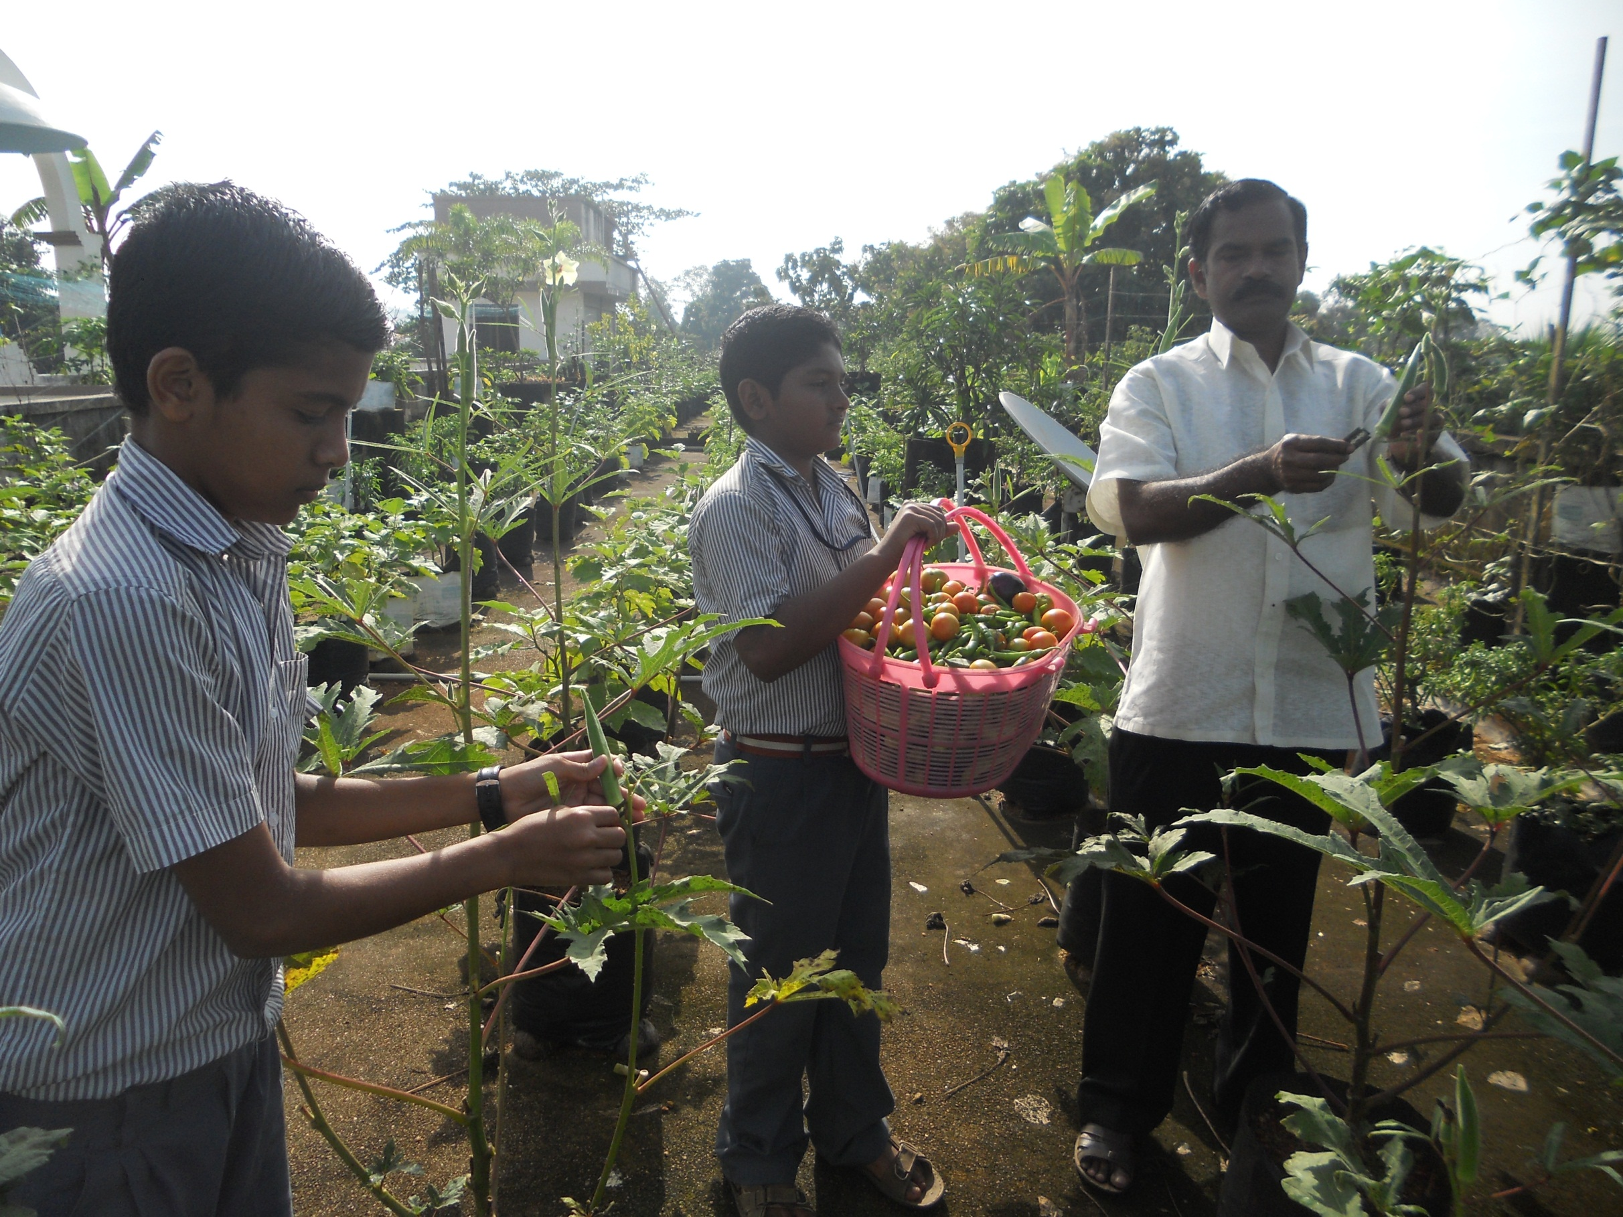

Slide 45
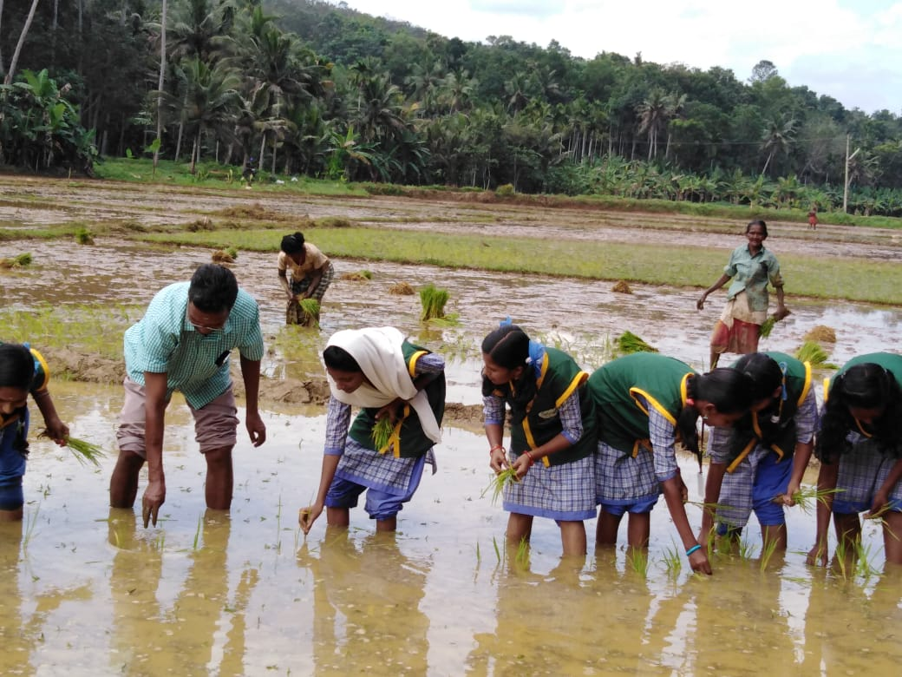

Slide 46
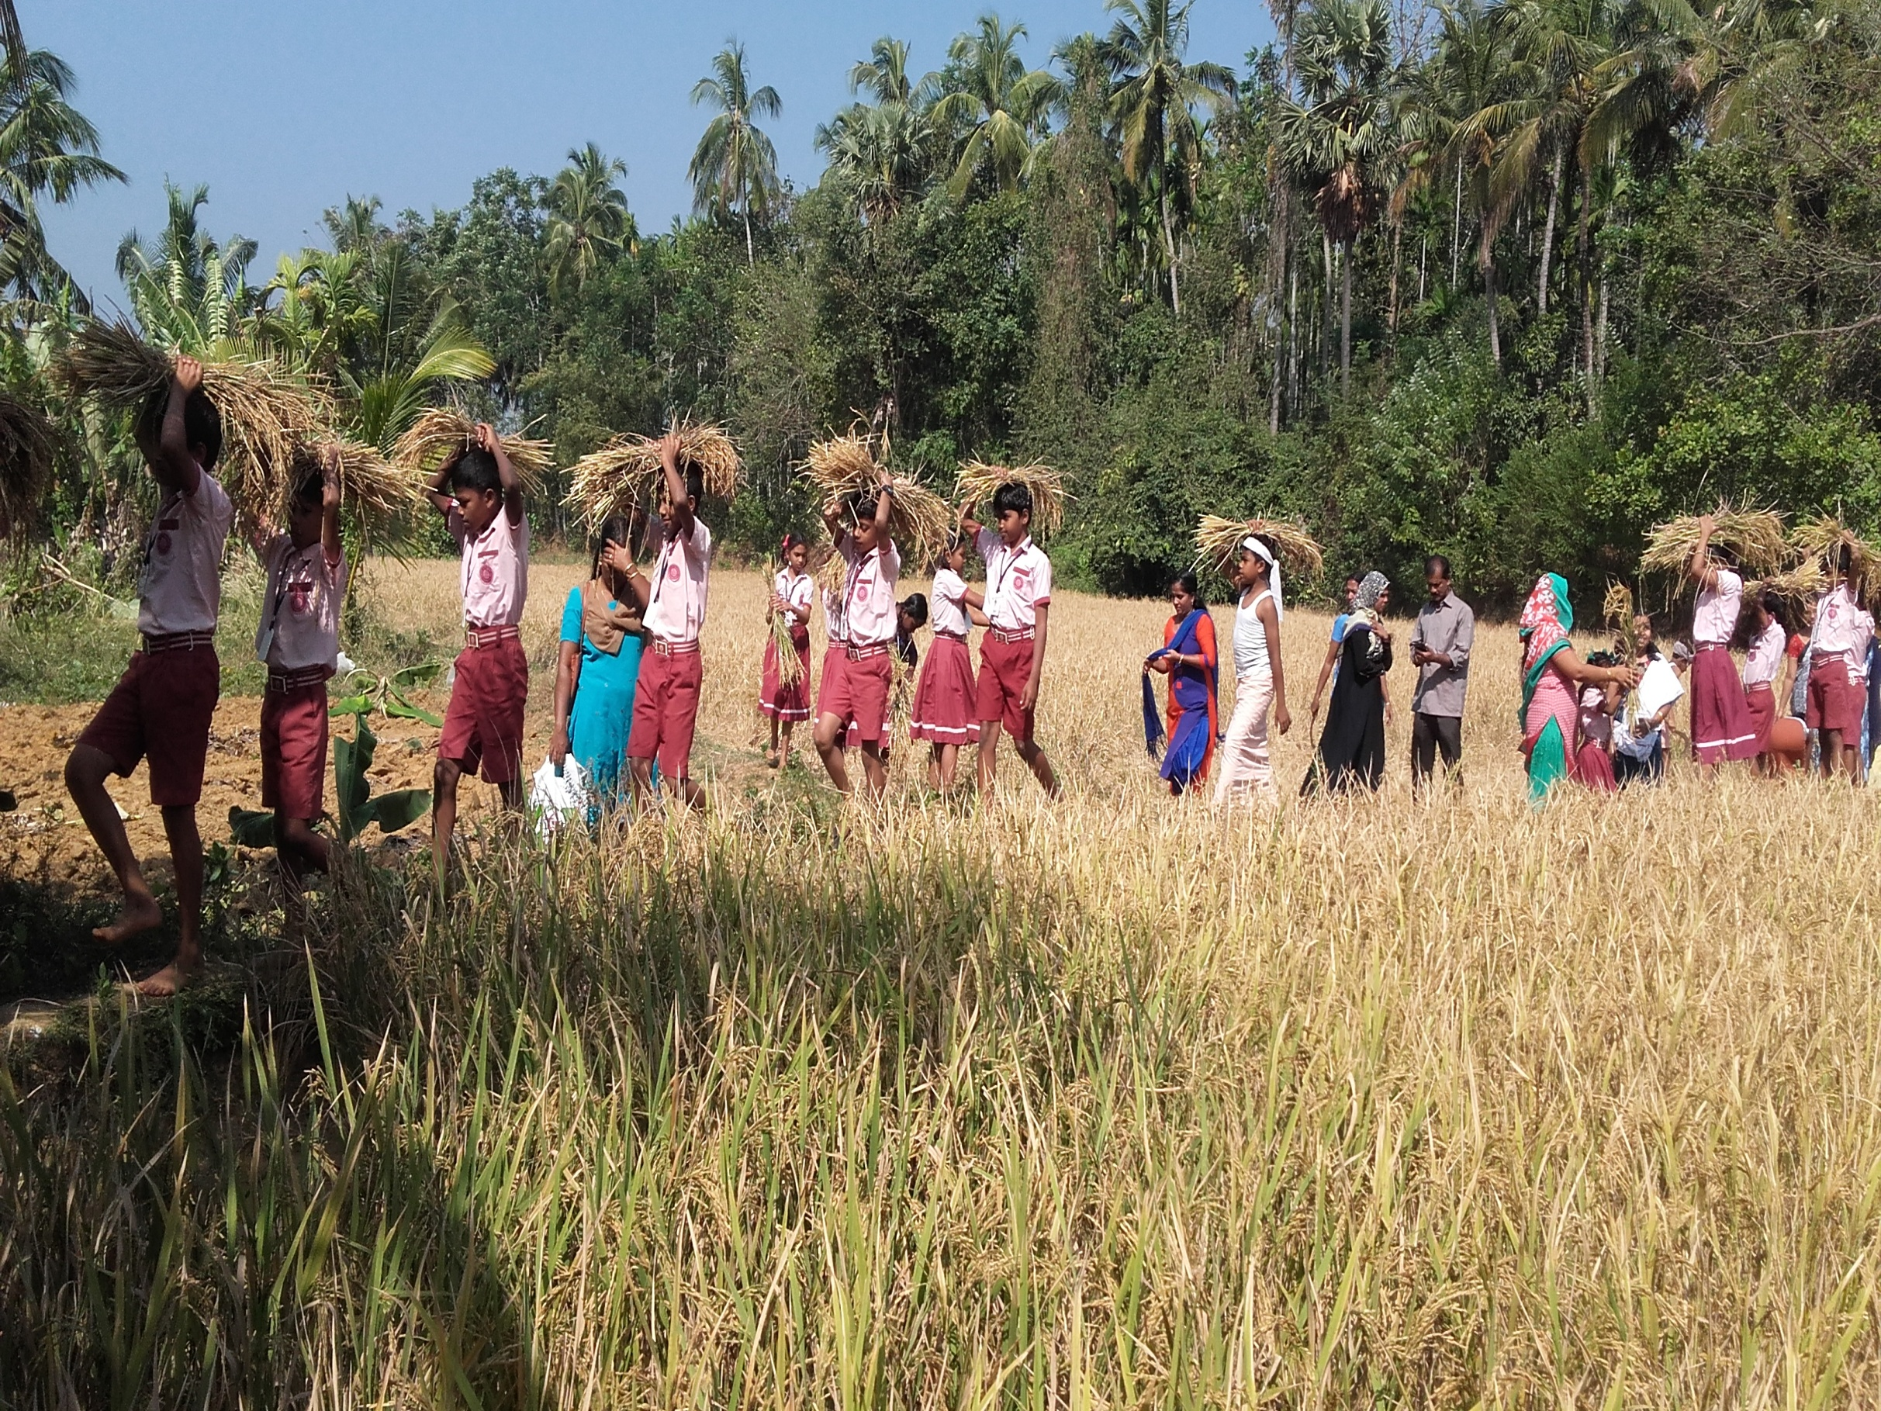

Slide 47
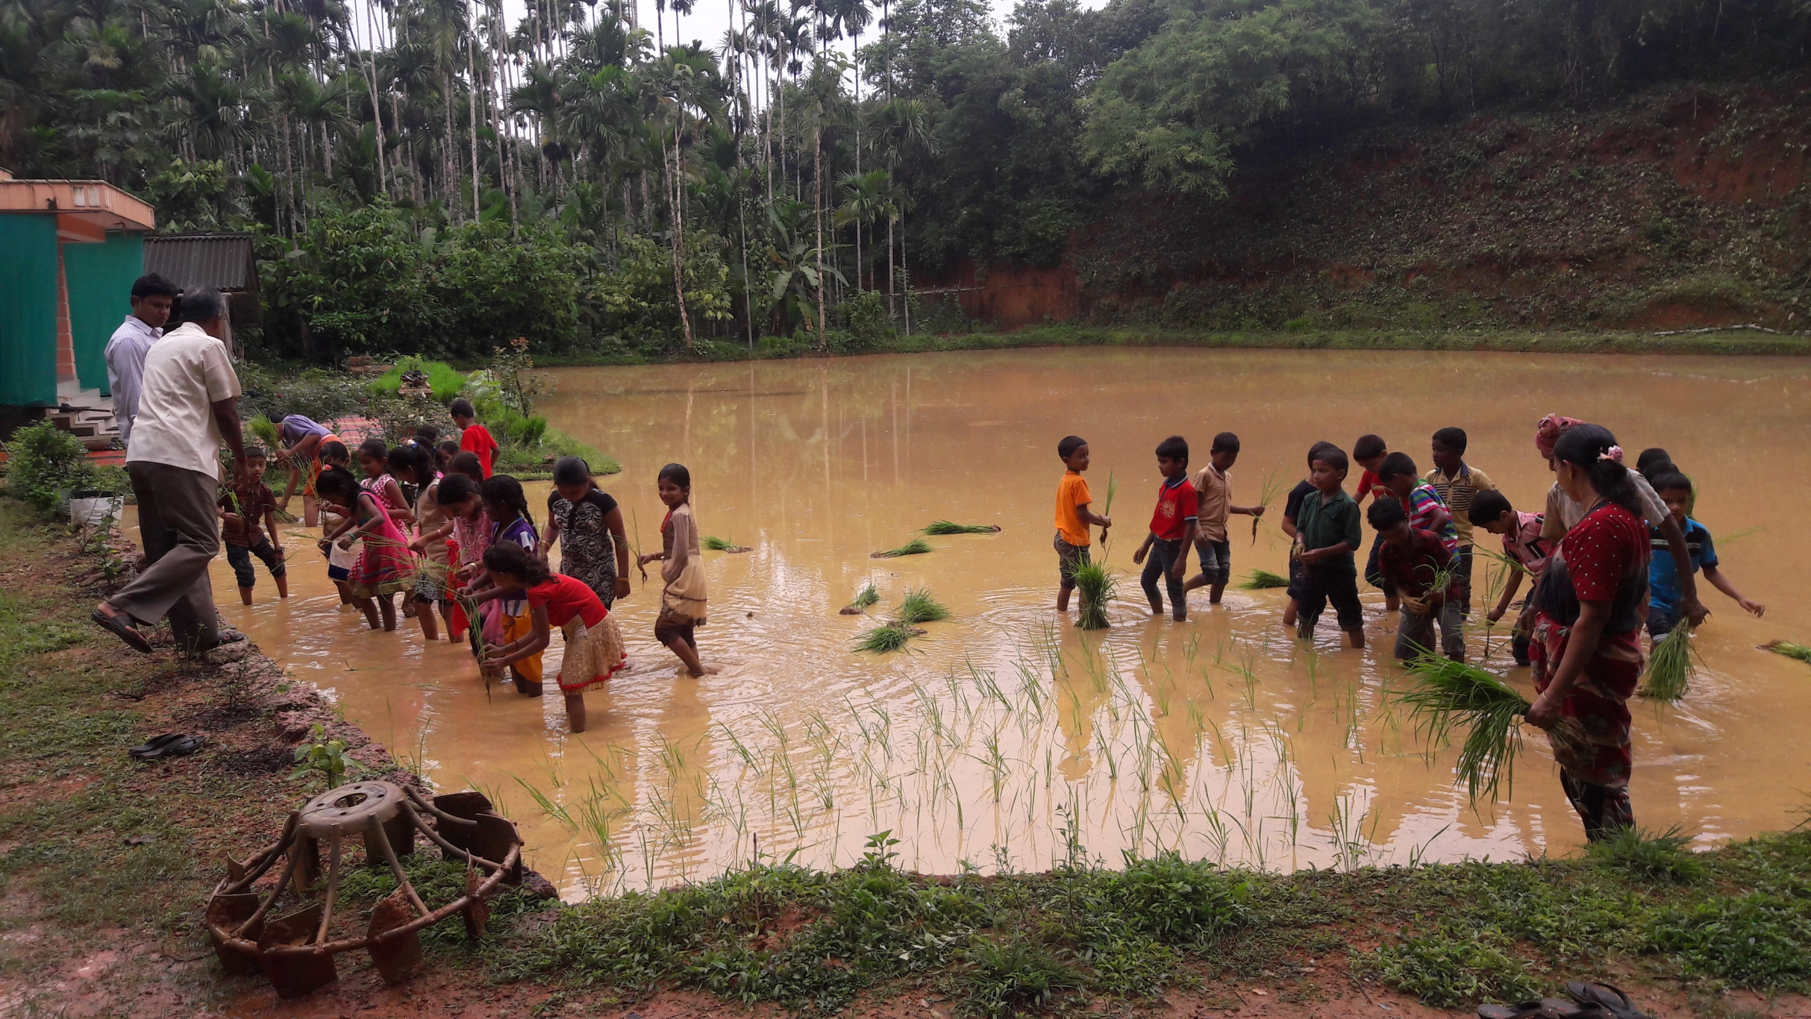

Slide 48
CONCLUSION
In Kerala,Mid day Meal Programme has become a massive movement with people’s participation at all levels.
Community participation and constant Monitoring have made MDM Programme a great success in Kerala.
The support and involvement of Local Self Government institutions in the implementation of MDM programme is remarkable.
Local Self Government Institutions earmark 5 % to 10 % of their Plan Funds for MDM related activities.
Initiatives like school health programme, kitchen gardens, poultry farming, etc. are being launched in convergence with other Government departments such as Department of Agriculture, Department of Health, Animal Husbandry Department and Department of Social Justice.

Slide 49
THANK YOU
Presented By
A SHAJAHAN IAS
SECRETARY TO GOVERNMENT
GENERAL EDUCATION DEPARTMENT
GOVERNMENT OF KERALA.A.S

